Slide 1
Reading Group
Clay Codes: Moulding MDS Codes
to Yield an MSR Code
2021/11/14
Presenter: Tianyang Niu

Slide 2
Outline
1
Background
2
Motivation
3
Design
4
Evaluation
3
5
Conclusion

Slide 3
Outline
1
Background
2
Motivation
3
Design
4
Evaluation
3
5
Conclusion

Slide 4
Background
Scalar Codes
Vector Codes
MSR Codes
Ceph

Slide 5
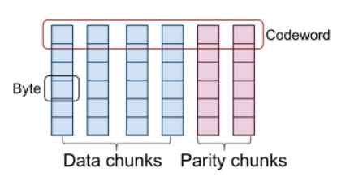
Background
Scalar Codes
n=k+m
L bytes

Slide 6
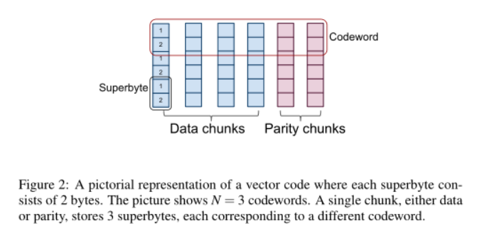
Background
Vector Codes
ordered collections of α bytes(superbyte)
n = m+k
N = L/k

Slide 7
Background
MSR Codes
ordered collections of α bytes(superbyte)
n = m+k
N = L/k

Slide 8
Background
MSR Codes
node containing α bytes
d helper nodes
Range k to n-1
β = α/(d-k+1)
d β
M=k α

Slide 9
Background
Ceph
a distributed storage system
OSD
Object Storage Daemon
PG
place-ment groups
pool
PG
PG
OSD
OSD
OSD
OSD
PG
PG
OSD
OSD
OSD
OSD

Slide 10
Background
Ceph
a large object
divided into smaller units called stripes
PG
object
p-OSD

Slide 11
Outline
1
Background
2
Motivation
3
Design
4
Evaluation
3
5
Conclusion

Slide 12
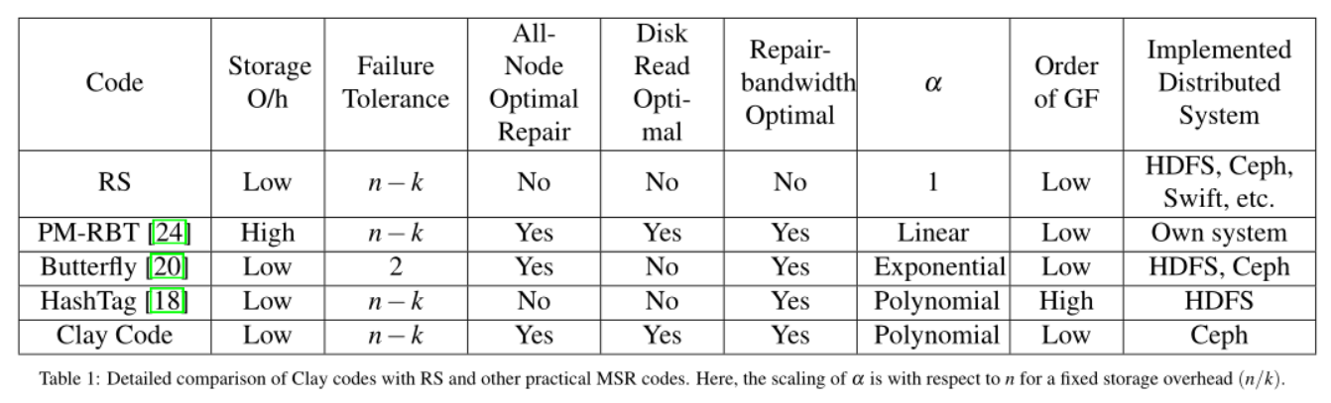
Motivation
接下来调研一下

Slide 13
Outline
1
Background
2
Motivation
3
Design
4
Evaluation
3
5
Conclusion

Slide 14
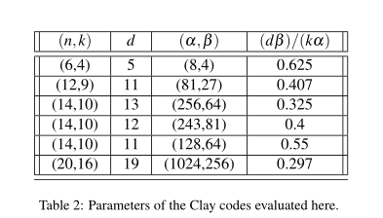
Design
Clay Code
N=1,L= α

Slide 15
Design
Clay Code
N=1,L= α
n=4,k=2
d=3
α=4, β=2
M=8
0.75

Slide 16
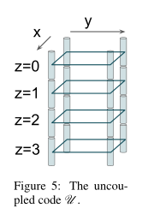
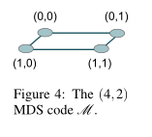
Design

Slide 17
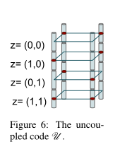
Design
x=z_{y}

Slide 18
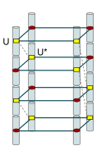
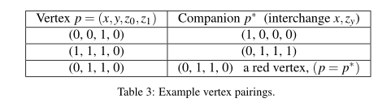
Design
interchanging the values of x and z_{y}

Slide 19
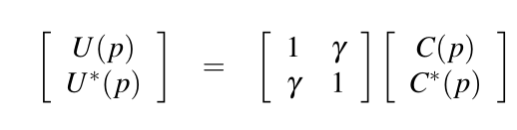
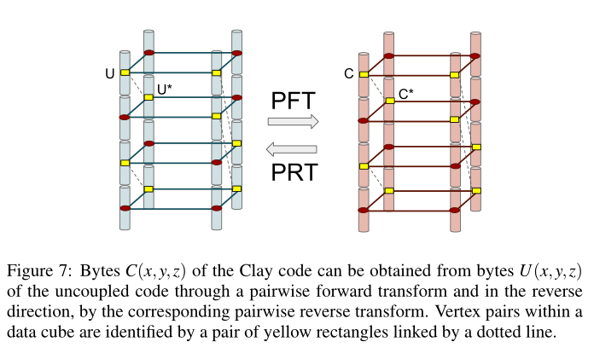
Design

Slide 20
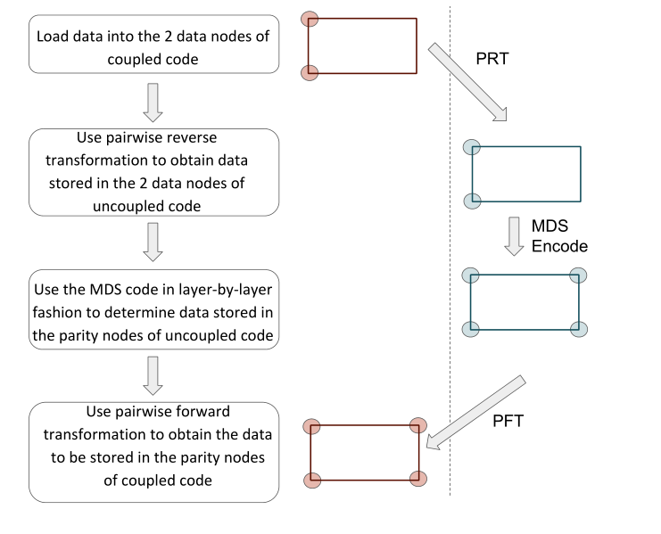
Design

Slide 21
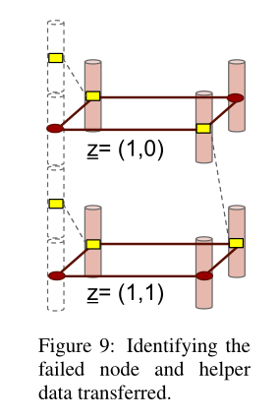
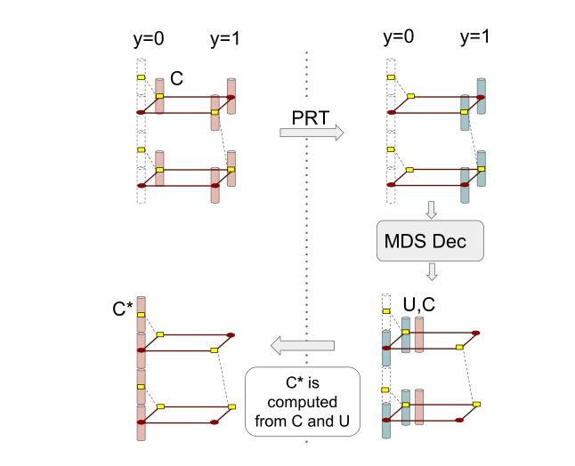
Design

Slide 22
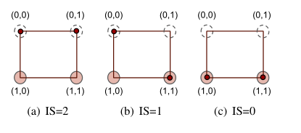
Design
Intersection Score

Slide 23
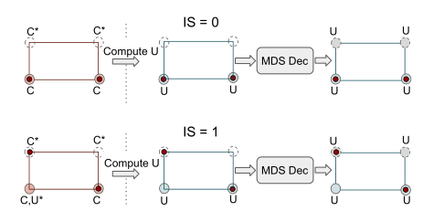
Design
Decoding
layer-by-layer
in order of increasing IS

Slide 24
Design
Clay code parameters
(n=qt,k,d)
(α=q^{t},β=q^{t−1})
q= (d−k+1)

Slide 25
Design
Clay codes for any(n,k,d)
q= (d−k+1) divide n
(n=14,k=10,d=13),q=d−k+1=4
n’=16
k’=12
s= n’-n=2
shortening

Slide 26
Implementation
Jerasure and GF-Complete
U-buffer
Size nL=Sn/k bytes

Slide 27
Implementation
Pairwise Transforms
{U,U∗,C,C∗}
sure_matrix_dotprod()
Galois_w08_region_multiply()
Encoding
pretending that m parity chunks have been erased
Enabling Selection Between Repair & Decoding
Is_repair()

Slide 28
Implementation
Helper-Chunk Identification
mini-mumtodecode()
Fractional Read
Decode and Repair

Slide 29
Outline
1
Background
2
Motivation
3
Design & Implementation
4
Evaluation
3
5
Conclusion

Slide 30
Evaluation
Environment
M4.xlarge
(16GB RAM, 4 CPU cores)
500G ssd
Ceph storage cluster
consists of 26 nodes
One server
dedicated for the MON daemon
remaining 25 nodes
each run one OSD
12.2TB

Slide 31
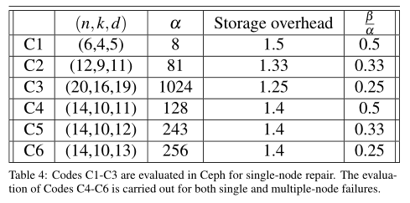
Evaluation
Clay code VS RS
C1 VS RDP code
C2 VS LRC
C3 VS (20,17)-RS code used in Backblaze
C4 C5 C6 vs facebook

Slide 32
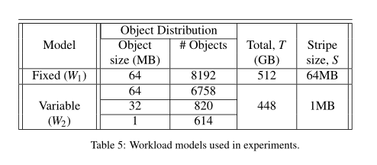
Evaluation
Overview
Workloads
W1 W2
PG
a single PG
512 PGs
Measurements
repair network traffic
repair disk read
repair time
encoding time
I/O performance

Slide 33
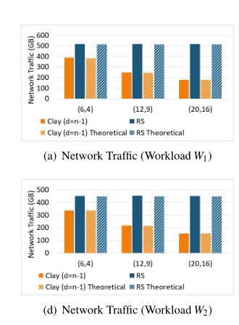
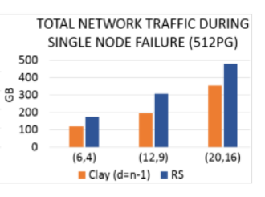
Evaluation
Network Traffic: Single Node Failure

Slide 34
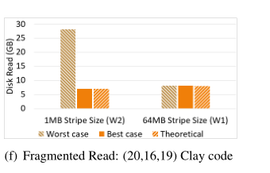
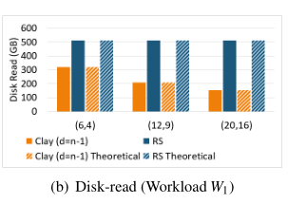
Evaluation
Disk Read: Single Node Failure
S=1MB
Chunk sieze L=S/k=64kB
repair of a node 16KB
β=256
fragments size L/α=64 bytes

Slide 35
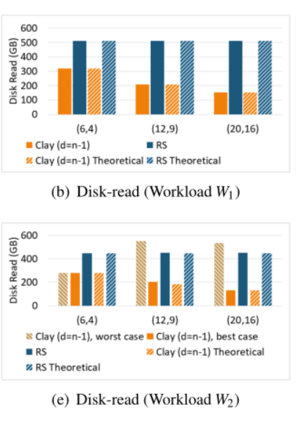
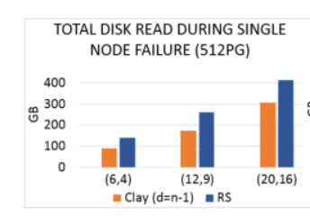
Evaluation
Tdβ/(kα)
T bytes for an RS code

Slide 36
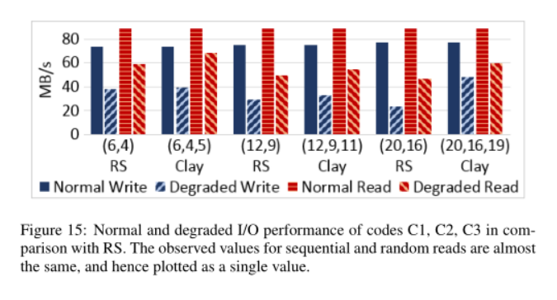
Evaluation
I/O Performance
(20,16,19)

Slide 37
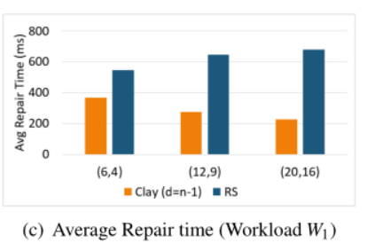
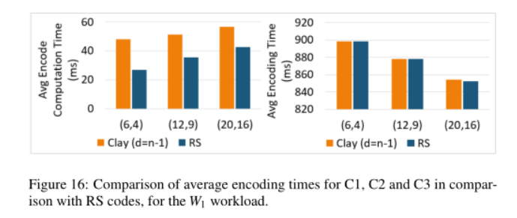
Evaluation
Repair Time and Encoding Time

Slide 38
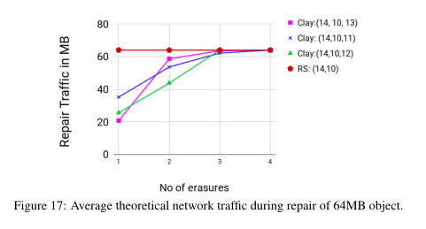
Evaluation

Slide 39
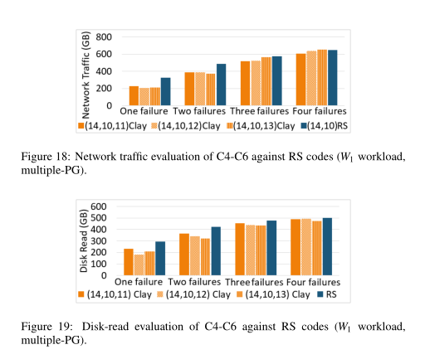
Evaluation

Slide 40
Outline
1
Background
2
Motivation
3
Design
4
Evaluation
3
5
Conclusion

Slide 41
Conclution
MDS codes
Clay codes have minimum possible repair bandwidth and disk I/O
MSR codes
Clay codes possess the least possible level of sub-packetization
make the leap from theory to practice

Slide 42
THANK YOU

